Slide 1

University of Pretoria
THE IMPACT OF COVID-19 ON THE TOURISM-TRANSPORT INTERFACE IN SOUTH AFRICA
17 March 2021
Prof Berendien Lubbe
Department Historical and Heritage Studies,
University of Pretoria
Dr Joachim Vermooten
Department Transport and Supply Chain Management
University of Johannesburg

Slide 2
Presentation Outline
Aim and objectives of the study
Methodology
Symbiotic relationship between transport and tourism
The tourism-transport interface
Brief overview of domestic and inbound transport trends (road and air)
Modes (Pre-Covid, Current, Post-Covid)
  Air
  Road
    Car rental
    Bus/Coach
Overall conclusions

Slide 3
Overall aim of the study
The study aims to explore the impact of COVID-19 on the Tourism-Transport Interface with a view to proposing a scenario where this relationship might create opportunities for tourism to prosper post COVID-19.
Objectives
To describe the Tourism-Transport Interface in South Africa
To identify trends and factors in the tourism-transport relationship that have an impact on the growth of tourism
To assess the impact of COVID-19 on the tourism-transport relationship.
To develop a future scenario where the tourism-transport relationship might create opportunities for tourism to prosper post COVID-19.
Notes:
To

Slide 4

Research Methodology
Literature and secondary data analysis on
  Overall tourism/transport interface
  Modes of transport, with particular reference to air and road transport.
Interviews with senior stakeholders in the aviation, bus/coach and car rental industries, supplemented by available statistics, to provide insight into the impact of COVID-19 on the relevant sectors.
Scenario planning workshops with leaders in the aviation (completed), car rental (completed) and coach/bus travel (pending) sectors.

Slide 5
The symbiotic relationship between transport and tourism
Transport supports tourism growth
Between 2014 and 2018
  Domestic tourists spent approximately 47% on transport
  Inbound tourists spent approximately 27% on transport
Two-thirds of new jobs created by tourism in 2017 were in the transport sector
Notes:
Of their travel budget

Slide 6
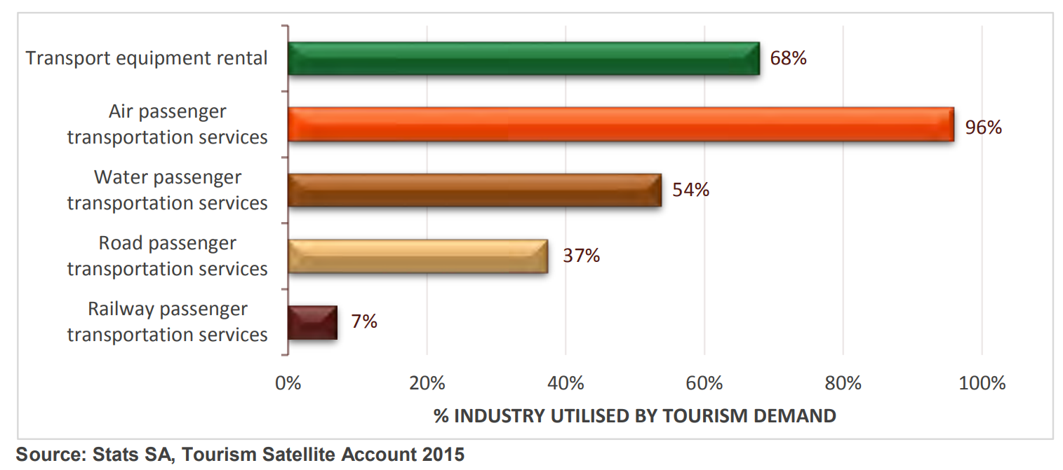
Tourism demand contributes substantially to the transport industry (2015)
Notes:
Of their travel budget

Slide 7
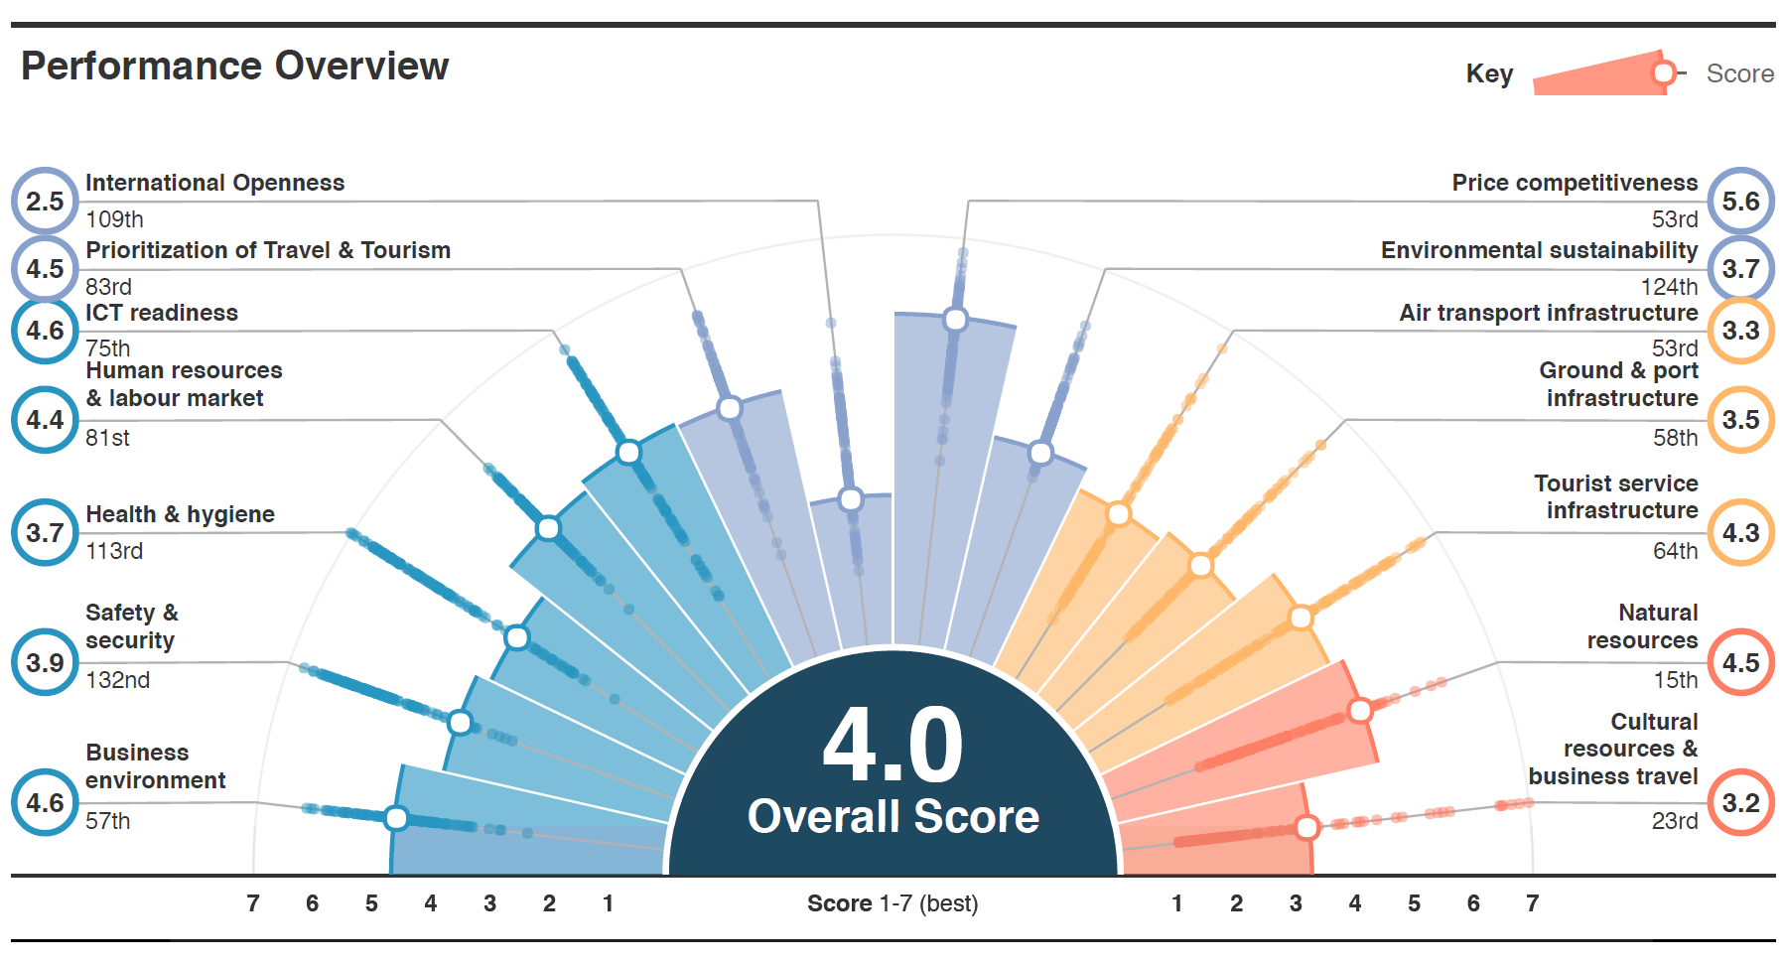
Transport is a determinant of tourist destination competitiveness
Source: Travel & Tourism Competitiveness Index 2019 edition
Notes:
Out of 140
Must distinguish between competitiveness and attractiveness. Competitiveness is a much wider concept which includes how tourism can benefit South Africa and all its people.

Slide 8
Transport is a driver of tourism demand and supply
Successful transport-tourism relationships depends on accessibility and connectivity to meet tourism demand by:
Linking the source markets with the host destination
Providing mobility and access within a destination area
Facilitating travel along a recreational route which is itself a tourism attraction
Providing mobility within an actual tourism attraction
Necessitates a framework which provides a means of understanding:
how tourists interact with transport, from the pre-travel booking stage through to the completion of the journey
the different modes of transport used by tourists
the organisations, processes and factors involved and their effect on the overall tourist experience (government and private sector).
The organisations that influence and regulate tourism transport

Slide 9
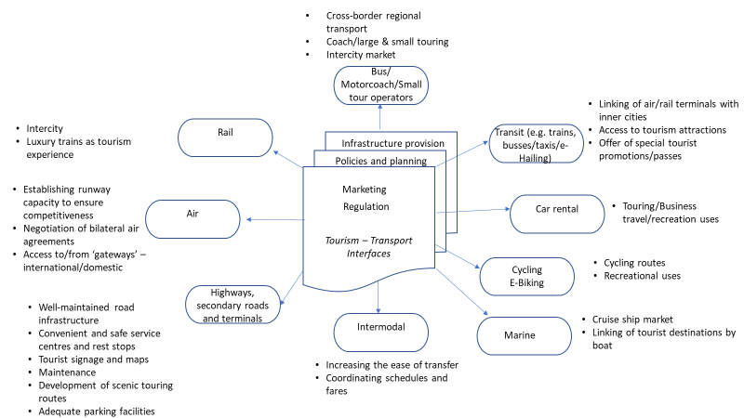
Tourism/Transport Interface Model
Source: Adapted from Page (2004:11) and Lamb and Davidson (1996)
Notes:
Tourism infrastructure: A tourism destination’s accessibility can be improved by developing transportation infrastructure network or by improving the network and tourist facilities e.g. As we have seen in aviation
Intermodal connectivity:A major objective of government transport policy is to achieve a co-ordinated and integrated transport system that is efficient, safe, secure, sustainable, accessible, financially viable and competitive, and meets both the short and long-term needs of the economy and the community. Transport policy is therefore closely aligned with economic development policies (including tourism), given that an efficient, competitive and sustainable transport system is a prerequisite for the movement of people, and ultimately the efficient and competitive functioning of the economy. Within this context, governments, working closely with the private sector, have a significant role to play in facilitating and enabling the provision of transport infrastructure and the regulation of transport networks and services.
DoT: INTEGRATED TRANSPORT PLANNING
Purpose: The programme exists to manage and facilitate national transport planning, related policies and strategies and coordinate regional as well as inter-sphere relations including providing economic modelling and analysis of the sector.
Mention of tourism in policy documents?

Slide 10
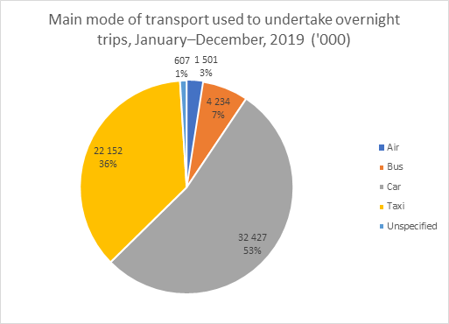
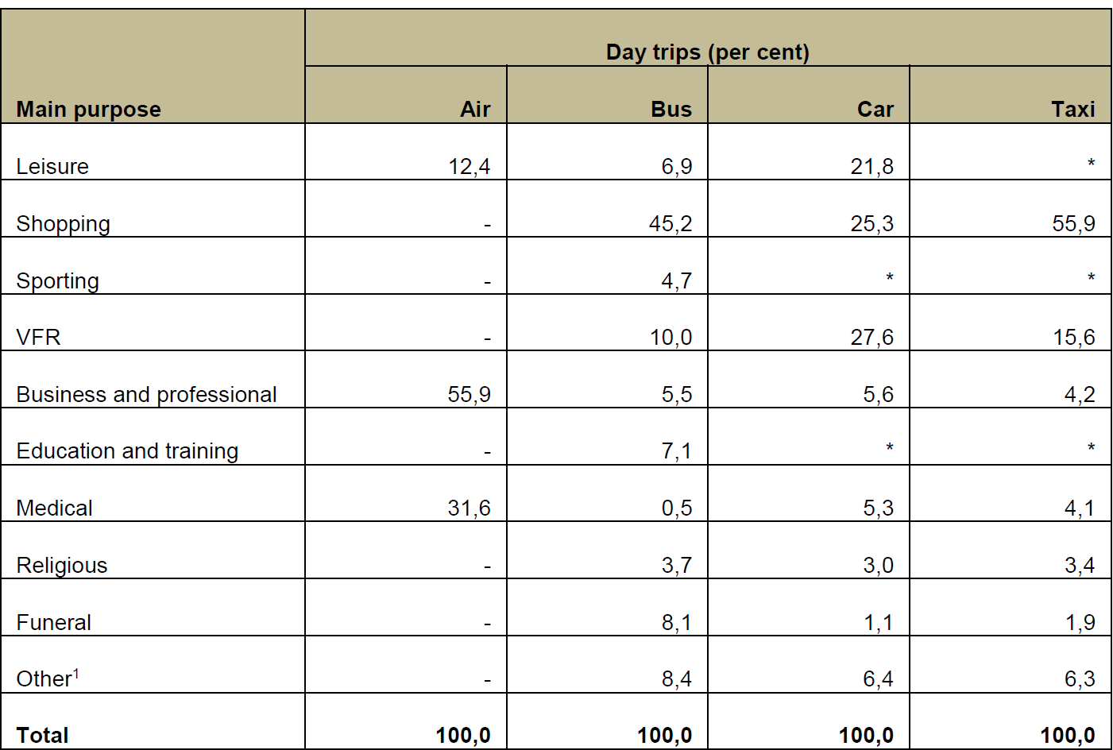
Brief overview of domestic and inbound transport trends
Domestic Travel 2019
Main purpose of most recent day trips by main mode of transport used, Jan–Dec, 2019
StatsSA Domestic Tourism Survey, 2019

Slide 11
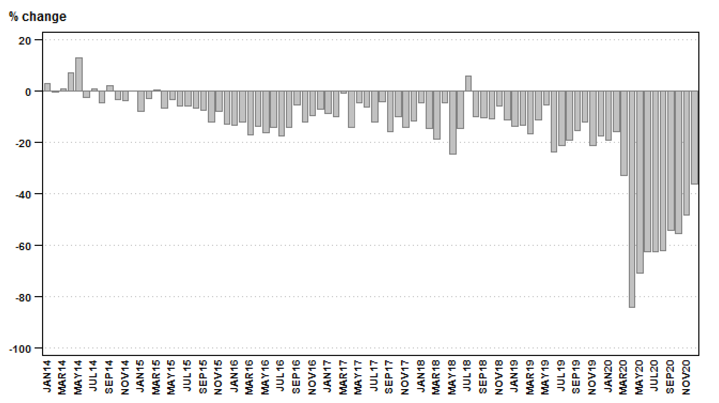
Overall passenger transportation: year-on-year percentage change in passenger journeys (road and rail) 2014 -2020
Includes:
Railway transport;• inter-urban bus;
coach passenger lines; safaris and sightseeing bus tours, metered taxis and ‘other’ passenger transport including renting of motor cars with drivers;
The number of passenger journeys decreased by 50,3% in 2020 compared with 2019. The corresponding income decreased by 40,8% over the same period.
StatsSA Land transport survey, December 2020

Slide 12
Road and Air: Annual Inbound Tourists
Source: Data StatsSA

Slide 13
Road and Air: Monthly Inbound Tourists
Inbound road tourists are substantially more than air inbound tourists.
Both Road and Air Inbound Tourists Arrivals
demonstrate substantial variation in monthly seasonal trends.
However the monthly trends differ between modes of transport.
Both experienced a substantial decline as a result of COVID19 travel restrictions.
Source: Data StatsSA

Slide 14
Road: Country of Origin of Inbound Tourists and Annual Increases
Source: Data StatsSA

Slide 15
Against this background we asked three questions pertaining to different modes (aviation, car rental, bus/coach industry):
How did each do pre-Covid?
How are they doing currently?
What to expect post-Covid?

Slide 16



Destinations with travel restrictions for international tourism on
1 February 2021
Aviation Sector
Source: World Tourism Organization’s (UNWTO) -Sustainable Development of Tourism Department. COVID – 19 related travel restrictions. A global review for tourism. Ninth report. 8 March 2021

Slide 17
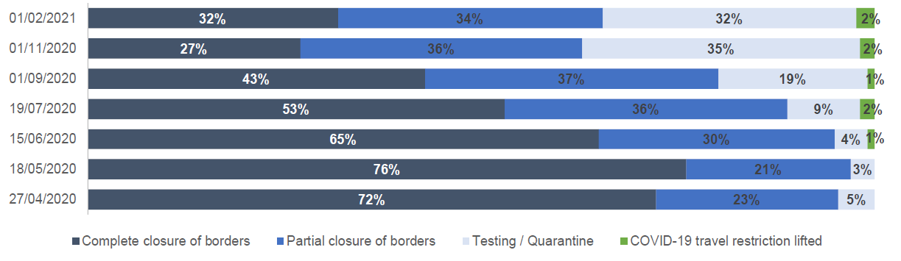
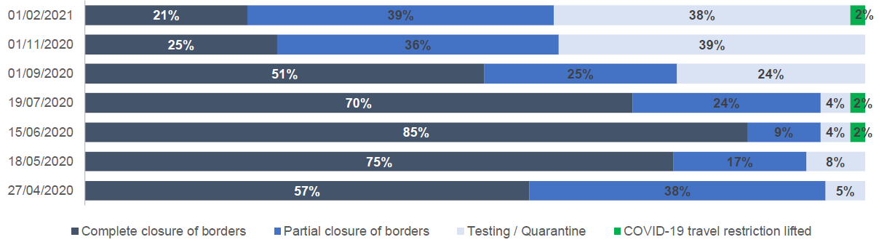
Evolution of African Travel Restrictions April 2020 to 1 February 2021
Evolution of Global Travel Restrictions April 2020 to February 2021
Source: World Tourism Organization’s (UNWTO) -Sustainable Development of Tourism Department. COVID – 19 related travel restrictions. A global review for tourism. Ninth report. 8 March 2021

Slide 18
Relative Size of South Africa’s Air Transport Activities
African airlines produced 2.6% (2019) and 2.1% (2020) of seats produced in the world
South African airlines produced 0.5% (2019) and 0.4% (2020) of seats produced in Africa
South African airlines produced 18% (2019) and 17% (2020) of seats produced in Africa
The % decline in seats produced were the highest in South Africa 60%
African airlines operated 2.1% (2019) and 1.5%
(2020) of flights in the world
South African airlines operated 0.4% (2019) and
0.2% (2020) of flights in Africa
South African airlines operated 19% (2019) and
16% (2020) of flights in Africa
The % decline in seats produced were the highest
in South Africa 60%
Source: ICAO https://data.icao.int/coVID-19/operational.htm

Slide 19
Air: Annual Inbound Tourists from Main Source Markets
Source: Data StatsSA

Slide 20
Air: Inbound Tourist Arrivals per Main Airport

Slide 21
Air: Inbound Tourist Arrivals: Intercontinental Source Markets
Source: Data StatsSA

Slide 22
Air: Inbound Tourist Arrivals: African Source Markets
Source: Data StatsSA

Slide 23
Air: Monthly Inbound Tourist Arrivals per Main Airport
Inbound tourists through ORTIA are higher than at Cape Town .
However, inbound traffic through Cape Town is demonstrate large seasonal swings on a monthly basis
At ORTIA small monthly variations (zigzags) are seasonally followed by sharp downturns.
Inbound traffic through both main airports experienced a substantial decline as a result of COVID19 travel restrictions in 2020.

Slide 24
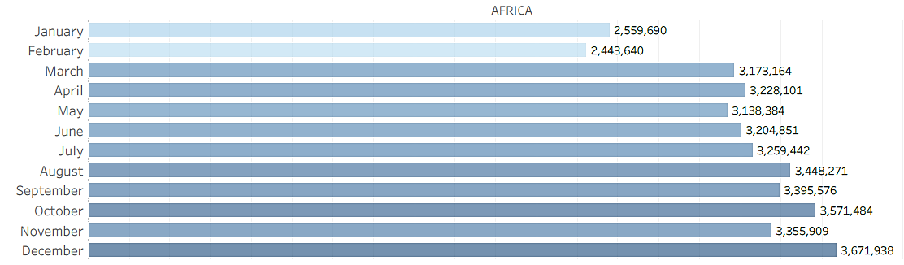
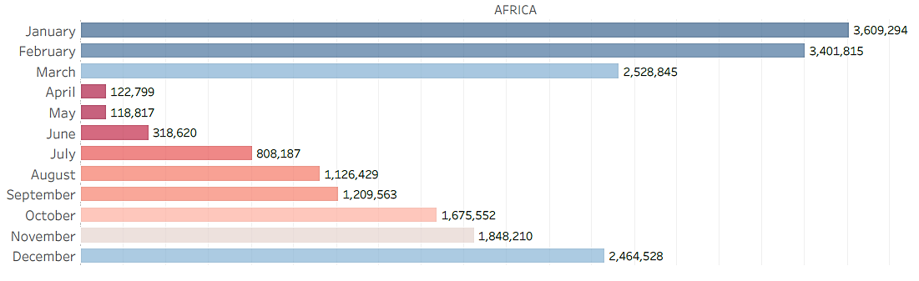
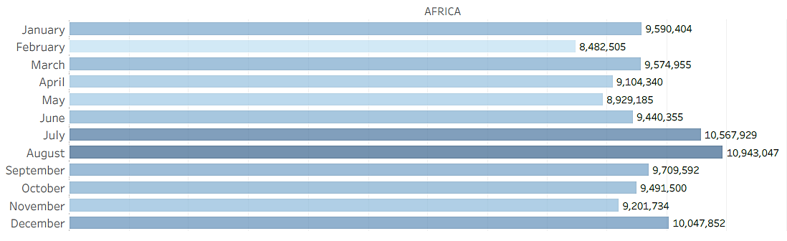
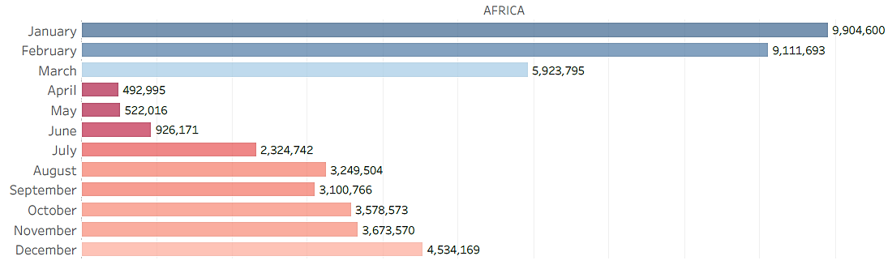
Africa Domestic Seat Production
2019 Base Year
2020
Africa International Seat Production
2019 Base Year
2020

Slide 25
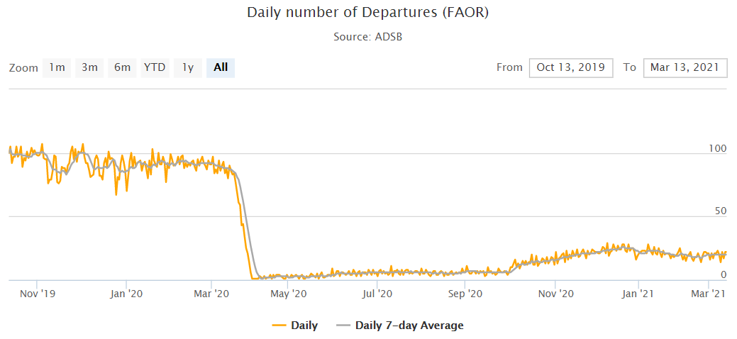
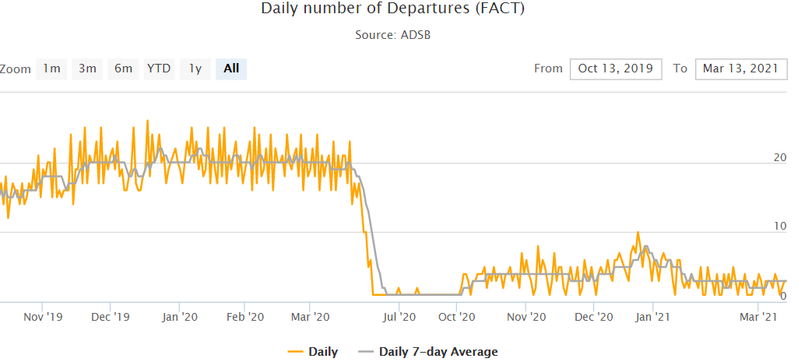
Daily Aircraft Departures at ORTIA and Cape Town Airports
Oliver Tambo International Airport (ORTIA)
Cape Town International Airport
Source: https://www.icao.int/safety/pages/covid-19-airport-status.aspx

Slide 26
Global Scheduled Seats Percentage Change year-over-year
Month compared with equivalent month in previous year i.e. January 2021 v's January 2020
Source: OAG-WEEKLY-TRACKER-22-February-2021
https://www.oag.com/coronavirus-airline-schedules-data#sec-two

Slide 27
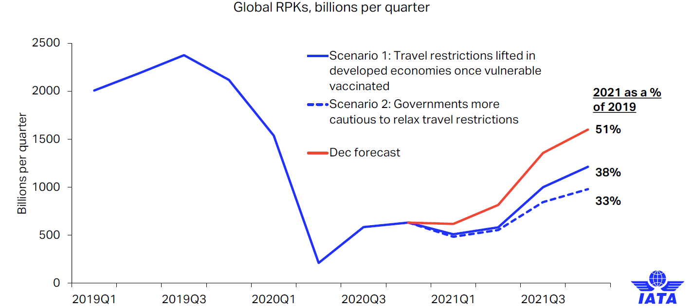
Air Traffic demand expected to be lower in RPKs
2021 is weaker than expected & risk of policy response to new virus variants and slow vaccinations
Source: IATA. Economics COVID-19Airline industry cash burn now expected to continue through 2021. 24 February 2021

Slide 28
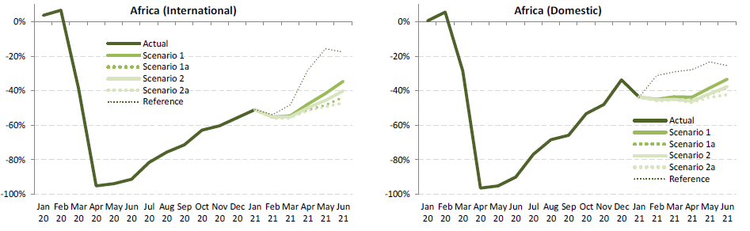
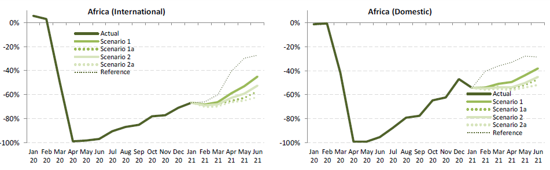
Latest ICAO Africa Recovery Scenarios
Seat capacity
Passenger numbers
Source: ICAO Air Transport Bureau. Economic Development. Effects of Novel Coronavirus (COVID‐19) on Civil Aviation: Economic Impact Analysis. Montréal, Canada. 24 February 2021

Slide 29
Some Observations of the Impact of COVID19 Measures
Vaccines are not the silver bullet expected
Vaccines are coming, but their effectiveness and their effective duration are uncertain
Vaccine production, distribution issues and rollout in all counties will take time.
The second and third waves (perhaps more) of the pandemic to follow
Every Government takes its own COVID19 restrictive measures (unpredictable and not co-ordinated with other Governments of International Agencies)
International cooperation becomes more important than vaccines.
International markets require some intermediate period allowing people to travel between nations. Crossing borders must be acceptable to each of the countries involved.
International flying will remain unstable for a long time until predictable border opening is restored and passenger confidence returns.
Many passengers remain fearful of air travel despite vaccine and alignment on procedures and processes in the travel chain despite substantial pent-up demand for travel.
Generally, due to economic contraction, there is lower disposable income and a lower propensity to fly (due to economic recessionary conditions)

Slide 30
Uncertainty on COVID19 measures and lower demand
Airline survival kit
Required Policy: enabling environment
Adapt to operate under uncertainty
Agility to take advantage of new opportunities and rapid exploratory reaction
More dynamic scheduling
Creativity
Experimentation
Risks taking
Balancing supply to lower demand levels
Viability & Sustainability
Better Government co-ordination of COVID19 restrictions
Shift in the regulatory policy to and enabling approach (more flexible to support industry to respond to market opportunities (which may be short term) , especially for sub-sectors with substantial regulatory, time and compliance requirements
Open regulatory framework to facilitate agility (to counter the restrictiveness of COVID19 regulations)
Opening of and lifting economic restrictions to accelerate air travel development
Clarity on rules
Competitive neutral Industry State financial aid

Slide 31
Important Fundamental Change that may affect Tourism to South Africa
Pricing of long haul flights may reduce the propensity of long haul tourism journeys
Business traffic is affected by:
  The closure of borders for international flights or foreign passport holders
  The general use of virtual events, doing business online; online meetings, working from home (WFH) is expected to be used in future.
  The pressure of corporate cost-cutting to reduce spending
The business and premium pricing model (higher-yielding traffic) supported long haul flying by cross-subsidising economy (coach) cabins for leisure passengers.
Cargo revenue (for belly freight) is also essential to contribute to the infrastructure of wide-body aircraft.
This may lead to a resurgence of long haul narrow-body aircraft operations (as already deployed on North Atlantic routes), which will affect the pricing model of economy seating on long haul flights .
Increase economy priced tickets may affect direct long-haul tourist destinations like South Africa. negatively

Slide 32
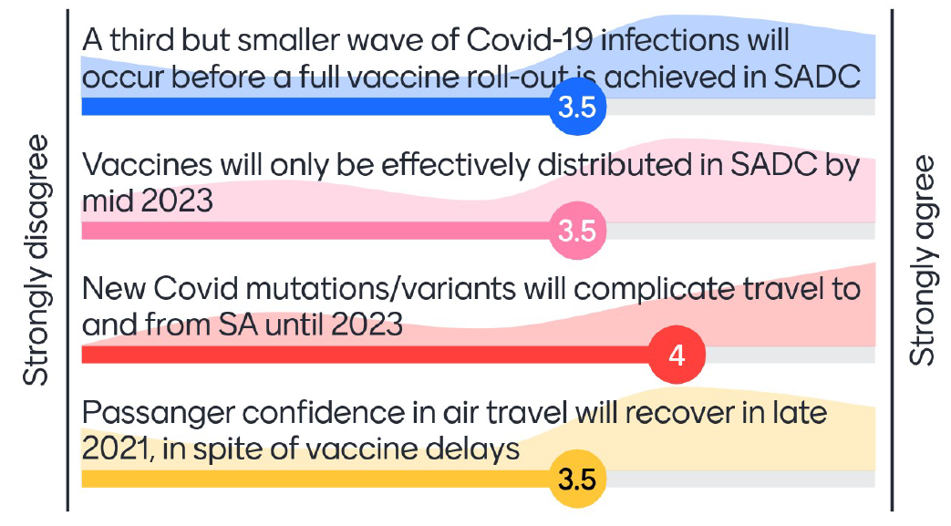
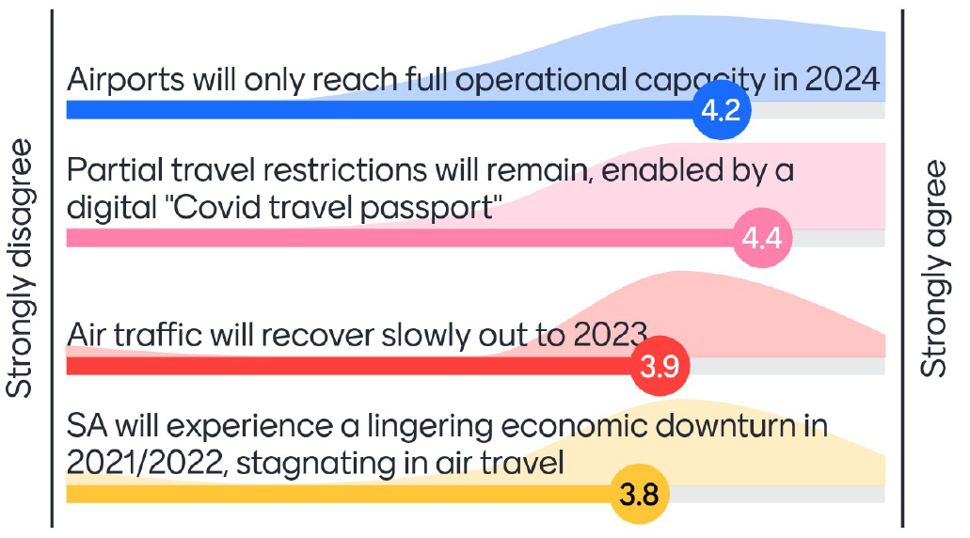
Aviation Industry Scenario Workshop Part 2
Global Health / Pandemic Trends
Global Industry Trends

Slide 33
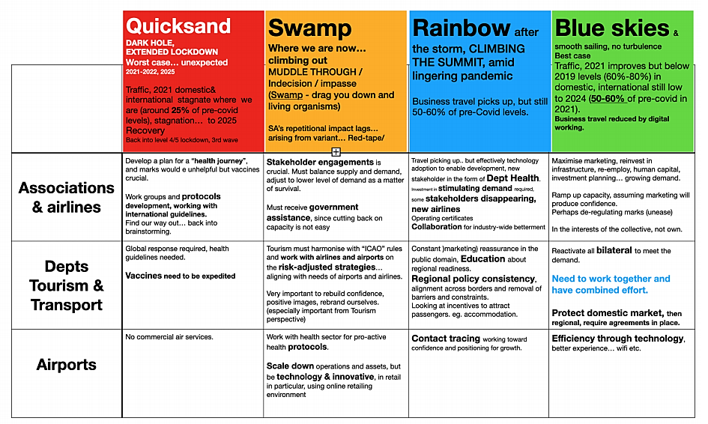

Outcome: Aviation Industry Scenario Workshop
Part 2
Strategic Scenarios

Slide 34
Proposed OECD Policy Responses to Coronavirus (COVID-19) in the aviation industry
The aviation industry is a key enabler of many other economic activities.
The dramatic drop in demand for passenger air transport (and freight, to a lesser extent) due to the COVID-19 containment measures is threatening the viability of many airlines, with many jobs at stake.
State financial aid (loans, loan guarantees, wage subsidies and equity injections) raise concerns about competition and the efficient use of public resources.
Government policies should:
  Prioritize sector-wide measures and competitive sustainability.
  Strike a balance between the need for support and the risk of distorting competition.
  Firm-specific support measures should not tilt the playing field with other firms in the aviation industry.
  Preserve business dynamics and allow exit.
Demand may be lower and structurally different from that before the crisis,
Governments should:
  Foster restructuring and avoid backing non-viable firms, but support displaced workers.
  Encourage investments in the green transition and environmental improvements.
  Address sustainability of the whole aviation value chain, including aircraft manufacturers and airports.
Policy responses in the aviation industry should be integrated across sectors in the low-carbon transition strategies
Source: OECD Policy Responses to Coronavirus (COVID-19). COVID-19 and the aviation industry: Impact and policy responses 15 October 2020. https://www.oecd.org/coronavirus/policy-responses/covid-19-and-the-aviation-industry-impact-and-policy-responses-26d521c1/

Slide 35
Car Rental Sector
Highly dependent on air travel
Derive bulk of revenue from airport locations - limited airport operations severely affected their bottom line.
Dominated by a number of large corporations:
Avis (30%); Bidvest (15%); Europcar (15%);Budget (10%)
Directly responsible for about 15,000 jobs, and thousands more across the value chain (vehicle sales, insurance, repairs, maintenance)
Notes:
South Africa's car rental industry experienced zero growth in 2018 and marginal nominal growth in 2019. While the weak economy caused rental volumes in the corporate, government, local leisure and insurance replacement subsectors to contract in 2019, declining international and domestic tourism numbers placed even further pressure on the stagnating industry.

Slide 36
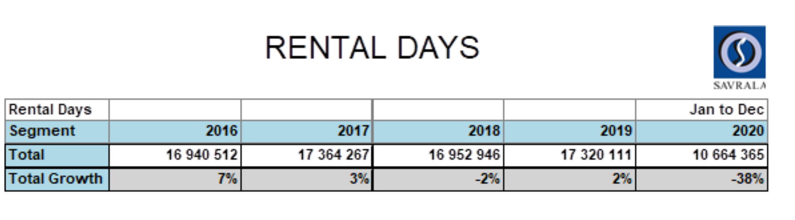
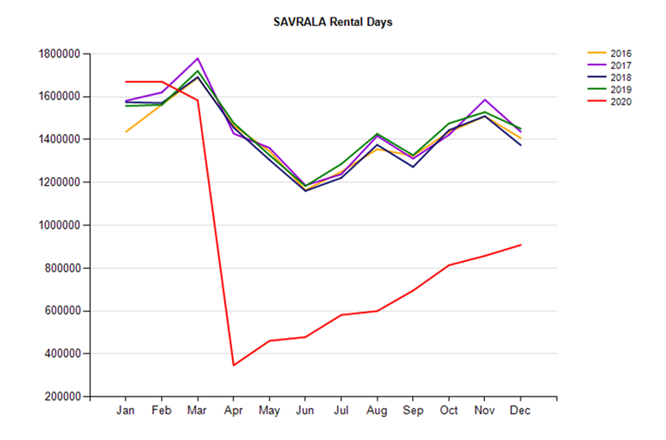
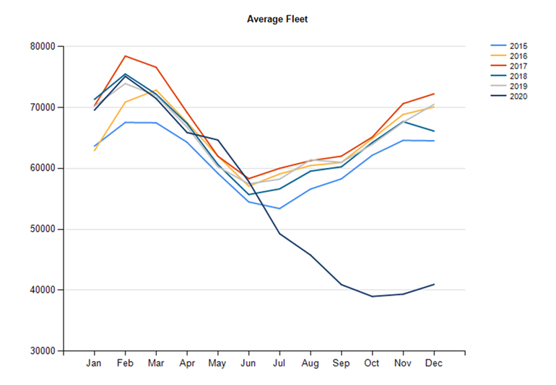
Market has been declining since 2016/2017
 | FLEET SIZE/UTILISATION
 | 2016 | 2017 | 2018 | 2019 | 2020
Avg Fleet | 64 784 | 67 153 | 64 744 | 65 253 | 54 970
Avg Growth | 6% | 4% | -4% | 1% | -15,8%
Avg Util | 71,5% | 70,9% | 71,8% | 72,8% | 53,1%
Avg Growth | 1% | -1% | 1% | 1% | -27,1%
Lockdown from 26 March 2020 for all non-essential businesses forced car rental companies to cancel all bookings. Travel ban seriously affected car rental companies.,

Slide 37
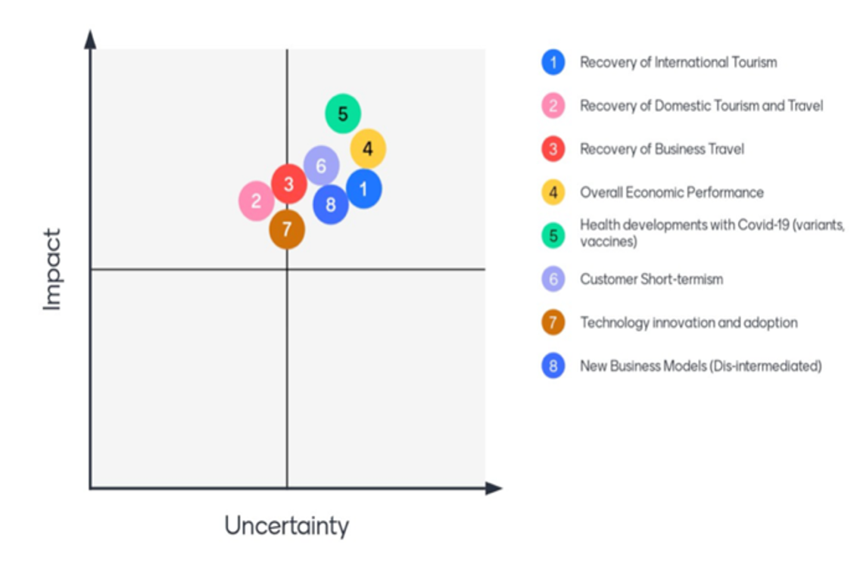
Results from Car Rental Interviews and Scenario Planning Workshop
Currently experiencing worst-case scenario where:
International tourism remains depressed
Poor economic performance with a fairly negative outlook
Constant uncertainty: andemic vs measures
Continuing job losses and
Impact and uncertainty of drivers and trends for recovery

Slide 38
Car Rental Post-Covid
Sector will experience:
lingering economic difficulties in spite of a improvement in the health pandemic.
a need to adjust to cope with national-level economic stagnation and lower demand.
likely rationalisation, including consolidation between competitors
Lengthy recovery of business travel, possibly not to previous levels
Re-invention of business models
Government would be called upon:
to liberalise the sector and the informal economy
to allow businesses to be more flexible and adaptive to changing conditions.
Partnership approach with
aggressive steps needing to be taken between tourism, labour, local government, health and their international counterparts to ensure a partnership-approach to dealing with the constraints on the sector.

Slide 39
Bus/Coach Industry
Cross-border (C-BRTA)
Inter-urban
Small operators
Tourism component
Offers about 51 000 seating capacity per month – (domestic and international tourism)
Annual revenue estimated at R 5 billion
Prior to COVID-19 sector under financial pressure due to increasing costs and currency fluctuations and declining market effects

Slide 40
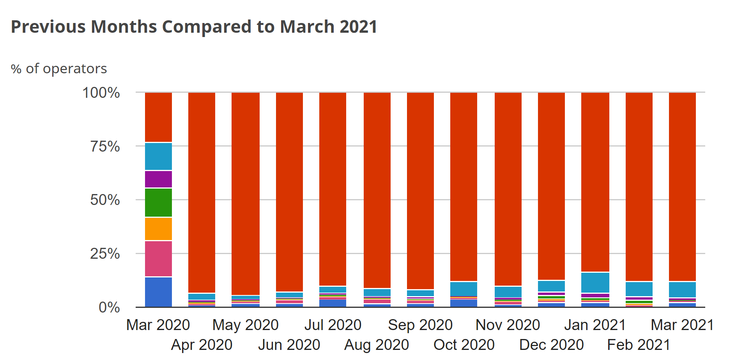
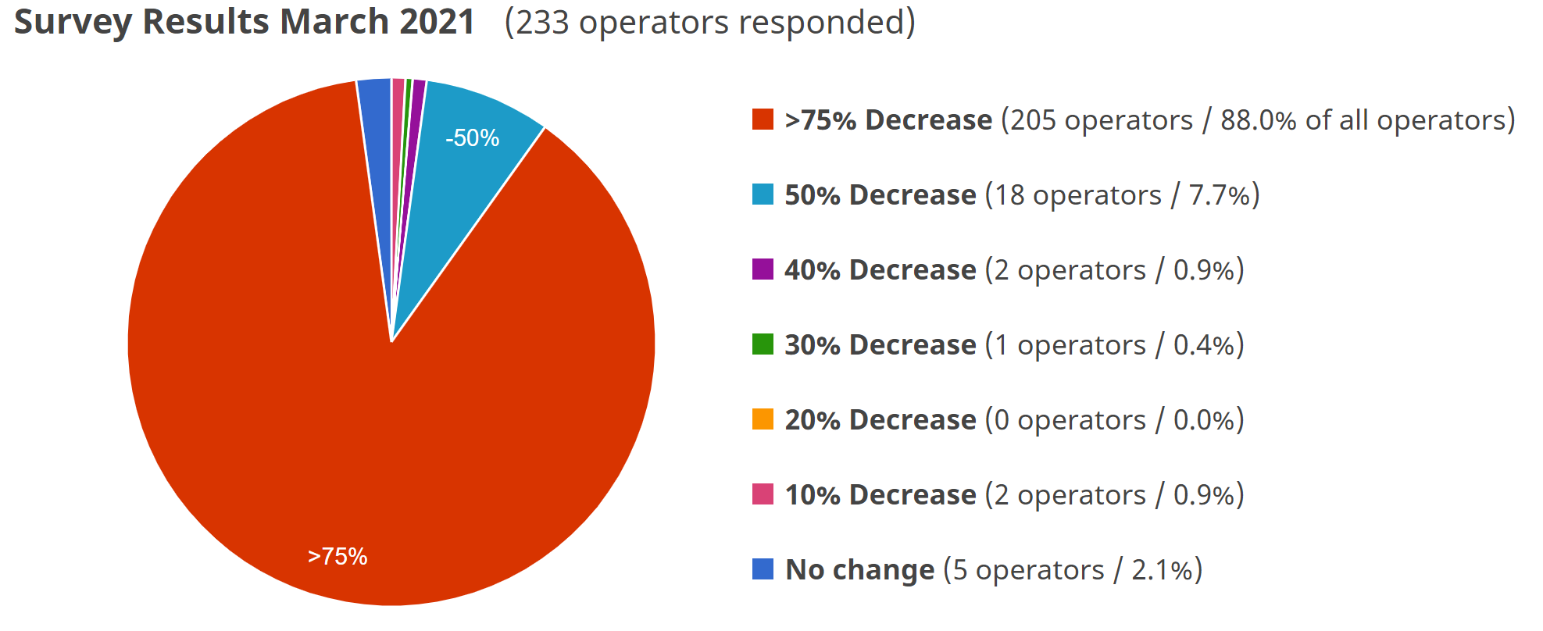
IMPACT OF COVID ON BUS/COACH TOURISM SECTOR
Since lockdown (SABOA, 2020):
Little to no revenue generated
Stationary fleet
Closures and retrenchments most in tourism part of this industry (employees range from general labour to specialized tasks such as tour operators /guides/ translators / drivers)
Cross-border: no tourism licences issued since March 2020
Small tour operators reliant on international visitors hit hardest
Possible impact for the year to date is approximately R 4, 6 BILLION
Limited government assistance
The impact of the coronavirus pandemic on Africa’s safari industry
Decrease in actual bookings due to the coronavirus outbreak
https://www.safaribookings.com/blog/coronavirus-outbreak

Slide 41
Post-COVID
Slow recovery only expected from when international travel resumes with a very low initial uptake
Operators are envisaged to be without income for a further period of time
The resultant impact will seriously affect SA’s ability to respond to national and international tourism needs in future
Government regulations must be more agile e.g. licencing

Slide 42
Overall conclusions
Transport modes generally experienced low to declining growth prior to COVID
COVID lockdown measures have been devastating to the tourism transport sectors, across all modes, both domestic and international.
Sectors continue to experience a “worst case scenario”
Recovery scenarios require:
  Economic growth
  Government agility to create an enabling environment for rapid growth
  Renewed tourist confidence amidst continued health safety uncertainty
  Sector streamlining and consolidation
  Innovative strategies for recovery and sustainability
    New business models
    New technologies
THANK YOU

